Slide 1
DIFFERENTIAL
EQUATIONS

Slide 2

DIFFERENTIAL EQUATION
“An equation consist of derivative of one or more dependent variable with respect to one or more independent variables.”
DEPENDENT AND INDEPENDENT VARIABLES
“Let $f\left(x\right)=y$ , where $y$ is dependent variable and $x$is independent variable. In other words, $y$ is called output and $x$ is input or feeding values.”
EXAMPLES
$y=x^{2}$

Slide 3

EXAMPLES OF DIFFERENTIAL EQUATIONs
There are some examples of differential equations.
$\frac{dy}{dx}+5y=0$
$\frac{dy}{dx}+3y=x^{2}$
$\frac{∂^{2}u}{∂x^{2}}+\frac{∂^{2}u}{∂y^{2}}=0$

Slide 4
CLASSIFICATION OF DIFFERENTIAL EQUATIONs
BY TYPE
ODEs
PDEs

Slide 5

Ordinary differential equation (ode)
“A differential equation which consist derivatives of one or more dependent variables w.r.t one independent variable is called ODE”
EXAMPLE
$\frac{dy}{dx}+y=0$
$\frac{d^{2}y}{{dx}^{2}}+\frac{dy}{dx}+y=e^{x}$

Slide 6
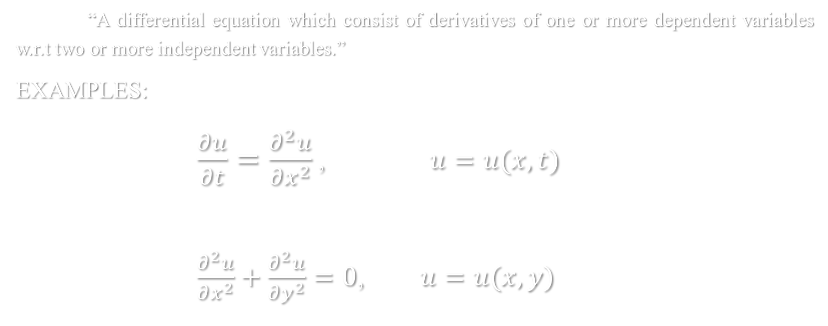
Partial differential equation (pdes)
“A differential equation which consist of derivatives of one or more dependent variables w.r.t two or more independent variables.”
EXAMPLES:
$\frac{∂u}{∂t}=\frac{∂^{2}u}{∂x^{2}}$, $u=u(x,t)$
$\frac{∂^{2}u}{∂x^{2}}+\frac{∂^{2}u}{∂y^{2}}=0$, $u=u(x,y)$

Slide 7
BY ORDER
Higher
Order
First Order

Slide 8
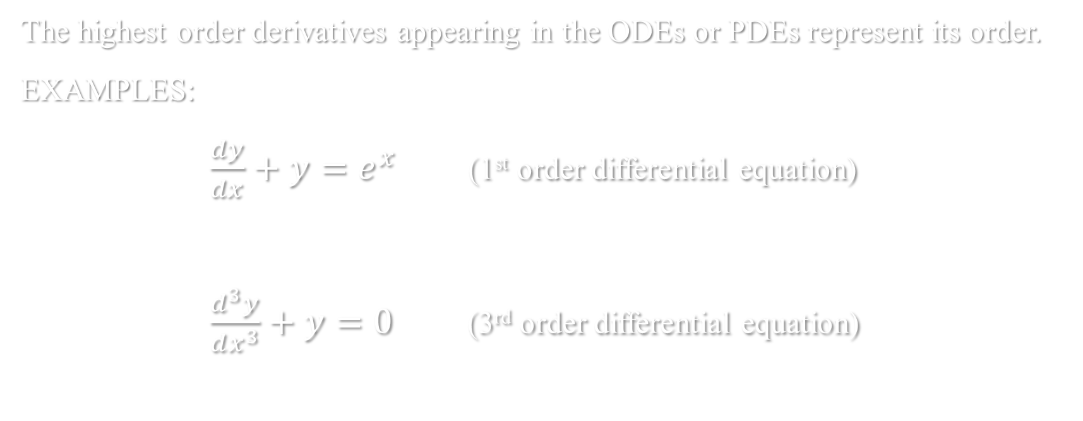
Order of differential equation
The highest order derivatives appearing in the ODEs or PDEs represent its order.
EXAMPLES:
$\frac{dy}{dx}+y=e^{x}$ (1st order differential equation)
$\frac{d^{3}y}{dx^{3}}+y=0$ (3rd order differential equation)

Slide 9
BY DEGREE
LINEAR
DEs
NON- LINEAR
DEs

Slide 10
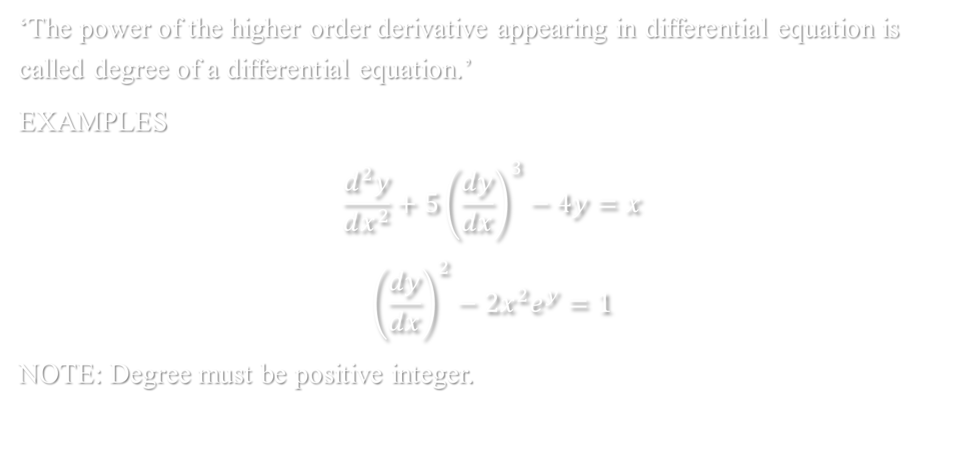
Degree of Differential Equations
‘The power of the higher order derivative appearing in differential equation is called degree of a differential equation.’
EXAMPLES
$$\frac{d^{2}y}{dx^{2}}+5{\left(\frac{dy}{dx}\right)}^{3}−4y=x$$
$${\left(\frac{dy}{dx}\right)}^{2}−2x^{2}e^{y}=1$$
NOTE: Degree must be positive integer.
1st degree & 2nd order
2nd degree & 1st order

Slide 11





LINEAR AND NON-LINEAR OF DIFFERENTIAL EQUATIONs
A differential equation ODE is said to be linear if
Dependent variable and its derivatives are linear.
The coefficients of $y^{′},y^{′′},…$are constant or at most depend on independent variable or in other words there will be no product of dependent variable and its derivatives.
Transcendental function of the dependent variable is absent.
Otherwise, ODE will be non-linear.
$y^{′}+P(x)y=Q(x)$, (1)
$y^{′′}+{P(x)y}^{′}+Q(x)y=R(x)$, (2)
$y^{′}+P(x)y=Q(x)y^{n}$, $n>1 (3)$
$y^{′}=P\left(x\right)+Q\left(x\right)y+R\left(x\right)y^{2}.$ (4)

Slide 12
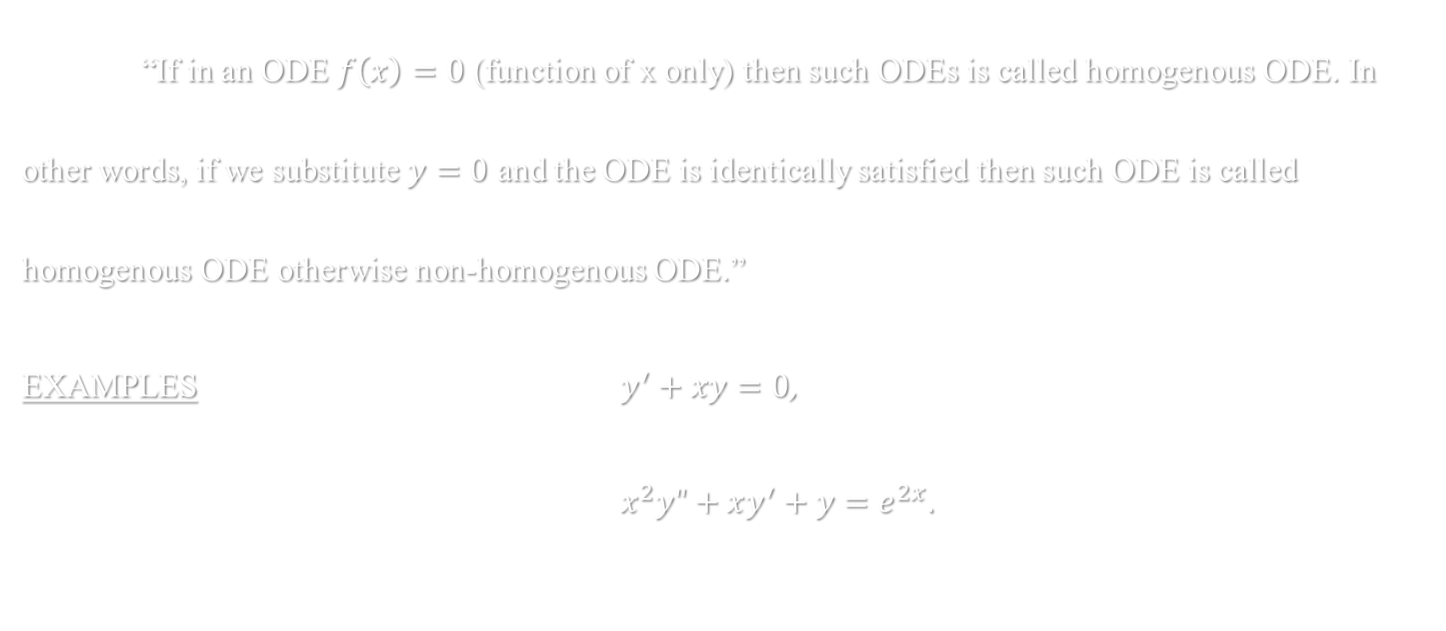
Homogenous & non-homogenous odes
“If in an ODE $f\left(x\right)=0$ (function of x only) then such ODEs is called homogenous ODE. In other words, if we substitute $y=0$ and the ODE is identically satisfied then such ODE is called homogenous ODE otherwise non-homogenous ODE.”
EXAMPLES $y^{′}+xy=0$,
$x^{2}y"+xy^{′}+y=e^{2x}.$

Slide 13
Applications of first order odes
In Simple electric circuits (RC and RL circuits)
Newton’s law of cooling
Populations dynamics and spreading of a viral disease

Slide 14
Applications of Pdes
Temperature distribution in a uniform rod of length L and its ends are at zero temperature/purely insulated via heat equation.
Disturbance in a uniform string of length L and its end are fixed via wave equation.

